Slide 1

SCSA1104 - Problem Solving using Programming with C and C++
UNIT III

Slide 2
UNIT III
Arrays: Single and Multidimensional Arrays-– Array as Function Arguments, Strings: String Handling Functions, Structure: Nested Structures – Array of Structures – Structure as Function Argument–Function that Returns Structure, Union.

Slide 3
ARRAY
An array is defined as the collection of similar type of data items stored at contiguous memory locations.
The array is the simplest data structure where each data element can be randomly accessed by using its index number.
NEED:
If we need to store multiple copies of the same data then it is very difficult for the user.

Slide 4
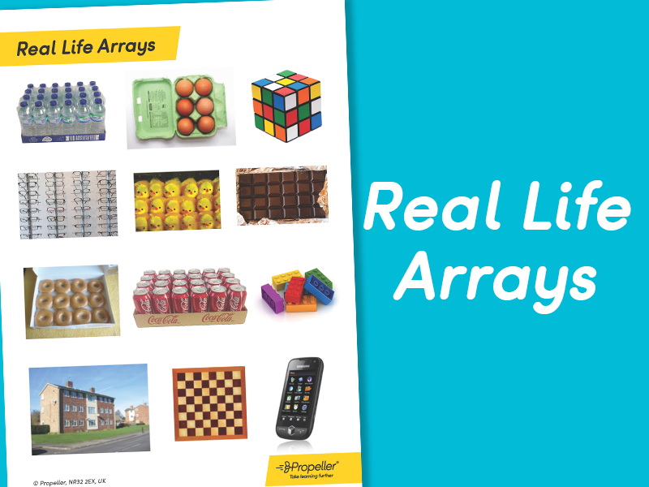

Slide 5
An array is a linear and homogeneous data structure
An array permits homogeneous data. It means that similar types of elements are stored contiguously in the memory under one variable name.
An array can be declared of any standard or custom data type
Example:
we have to store the roll numbers of the 100 students the we have to declare 100 variables named as roll1, roll2, roll3, ……. roll100 which is very difficult job

Slide 6
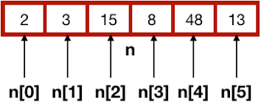

Slide 7
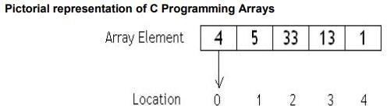
The above array is declared as int a [5]; a[0] = 4; a[1] = 5; a[2] = 33; a[3] = 13; a[4] = 1;
In the above figure 4, 5, 33, 13, 1 are actual data items. 0, 1, 2, 3, 4 are index variables.

Slide 8
Characteristics of an array
All the elements of an array share the same name and they are distinguished from one another with the help of the element number.
Any particular element of an array can be modified separately without disturbing the other elements.
Any element of an array a[ ] can be assigned or equated to another ordinary variable or array variable of its type.
Array elements are stored in contiguous memory locations.

Slide 9
Array Declaration:
Declaring Arrays
To declare an array in C, a programmer specifies the type of the elements and the number of elements required by an array as follows:
type arrayName [ arraySize ];
This is called a single-dimensional array.
Ex: int a[5]

Slide 10
Initialization of Array
Initialization means assigning initial variable to an array.
int a[5] = { 1,2,3,4,5}
(or)
a[0]=1;//initialization of array
a[1]=2;
a[2]=3;
a[3]=4;
a[4]=5;
where a is the name of the array

Slide 11
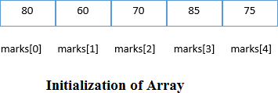

Slide 12
Example Program for Array Intialization :
#include<stdio.h>
Void main()
{
int i=0;
int marks[5];//declaration of array marks[0]=80;//initialization of array
marks[1]=60;
marks[2]=70;
marks[3]=85;
marks[4]=75;
//traversal of array
for(i=0;i<5;i++)
{
printf("%d \n",marks[i]);
}
}

Slide 13
int rollno[5]={ 11,12,13,14,15};
11
12
13
14
15
rollno[0]
rollno[1]
rollno[2]
rollno[3]
rollno[4]

Slide 14

Accessing Array :
We all know that array elements are randomly accessed using the subscript variable.
Array can be accessed using array-name and subscript variable written inside pair of square brackets [ ].
Elements are assigned to an array using below way
arr[0] = 51; arr[1] = 32; arr[2] = 43; arr[3] = 24; arr[4] = 5; arr[5] =26;

Slide 15
TYPES OF ARRAY:
One dimensional array
Two dimensional array or multi dimensional array.
ONE DIMENSIONAL ARRAY:
In this we deal with only one dimension when storing data in the memory.

Slide 16
// Program to find the sum of marks using arrays
#include <stdio.h>
void main()
{
int marks[5], i, n, sum = 0;
clrscr();
printf("Enter n: ");
scanf("%d", &n);
for(i=0; i<n; ++i)
{
scanf("%d", &marks[i]);
sum = sum+ marks[i];
}
printf(“Sum= %d", sum);
getch();
}
Output:
Enter N
5
10
20
30
40
50
Sum: 150

Slide 17
Operations with One Dimensional Array :
Deletion – Involves deleting specified elements form an array.
Insertion – Used to insert an element at a specified position in an array.
Searching – An array element can be searched. The process of seeking specific elements in an array is called searching.
Merging – The elements of two arrays are merged into a single one.
Sorting – Arranging elements in a specific order either in ascending or in descending order

Slide 18
Example Programs :
C Program for deletion of an element from the specified location from an Array
#include <stdio.h>
void main()
{
int arr[30], num, i, loc;
printf("\nEnter no of elements:");
scanf("%d", &num); //Read elements in an array
printf("\nEnter %d elements :", num);
for (i = 0; i < num; i++)
{
scanf("%d", &arr[i]); } //Read the location
printf("\nLocation of the element to be deleted :");
scanf("%d", &loc); /* loop for the deletion */
|}

Slide 19
while (loc < num)
{
arr[loc - 1] = arr[loc];
loc++;
}
num--; // No of elements reduced by 1
//Print Array
for (i = 0; i < num; i++)
printf("\n %d", arr[i]);
getch();
}
Output :
Enter no of elements: 5 Enter 5 elements: 3 4 1 7 8
Location of the element to be deleted: 3
3 4 18

Slide 20
2) C Program to delete duplicate elements from an array
void main()
{
int arr[20], i, j, k, size;
printf("\nEnter array size: "); scanf("%d", &size);
printf("\nAccept Numbers: ");
for (i = 0; i < size; i++)
scanf("%d", &arr[i]);
printf("\nArray with Unique list: ");
for (i = 0; i < size; i++)
{
for (j = i + 1; j < size;)
{
if (arr[j] == arr[i])
{

Slide 21
for (k = j; k < size; k++)
{
arr[k] = arr[k + 1];
}
size--;
}
else j++;
} }
for (i = 0; i < size; i++)
{
printf("%d ", arr[i]);
}
getch();
}
Output:
Enter array size: 5
Accept Numbers: 1 3 4 5 3
Array with Unique list: 1 3 4 5

Slide 22
3) C Program to find smallest element in an array
#include<stdio.h>
void main()
{
int a[30], i, num, smallest;
printf("\nEnter no of elements :");
scanf("%d", &num); //Read n elements in an array
for (i = 0; i < num; i++)
scanf("%d", &a[i]);
//Consider first element as smallest
smallest = a[0];

Slide 23
for (i = 0; i < num; i++)
{
if (a[i] < smallest)
{
smallest = a[i];
}
}
// Print out the Result
printf("\nSmallest Element : %d", smallest);
getch();
}
Output:
Enter no of elements : 5 11 44 22 55 99
Smallest Element : 11

Slide 24
4. C Program to find largest element in an array
#include<stdio.h>
void main()
{
int a[30], i, num, largest;
printf("\nEnter no of elements :");
scanf("%d", &num); //Read n elements in an array for (i = 0; i < num; i++)
scanf("%d", &a[i]);
//Consider first element as largest largest = a[0];
for (i = 0; i < num; i++)

Slide 25
{
if (a[i] > largest)
{
largest = a[i]; }
}
// Print out the Result
printf("\nLargest Element : %d", largest); getch();
}
Output:
Enter no of elements : 5 11 55 33 77 22 Largest Element : 77

Slide 26
5. C Program to reverse an array elements in an array
#include<stdio.h>
void main()
{
int arr[30], i, j, num, temp;
printf("\nEnter no of elements : ");
scanf("%d", &num); //Read elements in an array
for (i = 0; i < num; i++)
{
scanf("%d", &arr[i]);
}
j = i - 1; // j will Point to last Element
i = 0; // i will be pointing to first element

Slide 27
while (i < j)
{
temp = arr[i];
arr[i] = arr[j];
arr[j] = temp;
i++; // increment i
j--; // decrement j
}
printf("\nResult after reversal : ");
for (i = 0; i < num; i++)
{
printf("%d \t", arr[i]);
}
getch();
}
Output:
Enter no of elements: 5 11 22 33 44 55
Result after reversal : 55 44 33 22 11

Slide 28
C Program to insert an element in an array
#include<stdio.h>
int main() {
int arr[30], element, num, i, location;
printf("\n Enter no of elements:");
scanf("%d", &num);
for (i = 0; i < num; i++) {
scanf("%d", &arr[i]); }
printf("\n Enter the element to be inserted:");
scanf("%d", &element);
printf("\n Enter the location");
scanf("%d", &location);

Slide 29
//Create space at the specified location
for (i = num; i >= location; i--) {
arr[i] = arr[i - 1]; }
num++;
arr[location - 1] = element;
//Print out the result of insertion
for (i = 0; i < num; i++)
printf("n %d", arr[i]);
return (0);
}

Slide 30
C Program to Search an element
#include<stdio.h>
#include<conio.h>
void main()
{
int a[50],i,n,t,flag=0;
clrscr();
printf("Enter the value of n or the size of the array\n");
scanf("%d",&n);
printf("Enter the elements\n");
for(i=0;i<n;i++)
{
scanf("%d",&a[i]);
}
printf("Enter the element to be searched\n");
scanf("%d",&t);
for(i=0;i<n;i++)
{
if(a[i]==t)
{
flag=1;
break;
}
}
if (flag==1)
printf("found");
else
printf("Not found");
getch();
}

Slide 31
Merging two Arrays
#include<stdio.h>
#include<conio.h>
void main()
{
int k,a[50],b[50],m[50],i,n1,n2;
clrscr();
printf("Enter the size of array1\n");
scanf("%d",&n1);
printf("Enter the elements\n");
for(i=0;i<n1;i++)
{
scanf("%d",&a[i]);
m[i]=a[i];
}
k=i;
printf("Enter the size of array2\n");
scanf("%d",&n2);
printf("Enter the elements\n");
for(i=0;i<n2;i++)
{
scanf("%d",&b[i]);
m[k]=b[i];
k++;
}
printf("The merged array\n");
for(i=0;i<k;i++)
printf("%d\n",m[i]);
getch();
}

Slide 32
Sorting – Ascending Order
#include <stdio.h>
#include<conio.h>
void main() //default function for call
{
int a[100],n,i,j;
printf("Array size: ");
scanf("%d",&n);
printf("Elements: ");
for(i=0;i<n;i++)
{
scanf("%d",&a[i]);
}
for (int i = 0; i < n; i++) //Loop for ascending ordering
{
for (int j = 1; j < n; j++) //Loop for comparing other values
{
if (a[i] > a[j])
{
int tmp = a[i]; a[i] = a[j]; a[j] = tmp;
}
}
}
printf("\n\nAscending : "); //Printing message
for (int i = 0; i < n; i++)
{
printf(" %d ", a[i]);
}
getch();
}

Slide 33
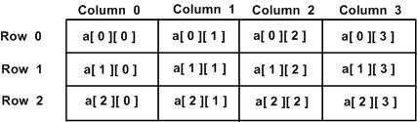
TWO DIMENSIONAL ARRAY:
The two-dimensional array can be defined as an array of arrays.
The 2D array is organized as matrices which can be represented as the collection of rows and columns.
DECLARING A 2D ARRAY:
arr[rows][column];

Slide 34
INITIALIZING TWO-DIMENSIONAL ARRAYS:
Two dimensional arrays may be initialized by specifying bracketed values for each row. Following is an array with 3 rows and each row has 4 columns.
int a[2][[2] = { {1,2}, {3,4} }; Where a[2][2] means there are two rows and two columns, in the nested brackets, the first set denotes values in the first row and next set in the second row.

Slide 35
Example:
#include<stdio.h>
int main()
{
int i=0,j=0;
int arr[4][3]={{1,2,3},{2,3,4},{3,4,5},{4,5,6}};
//traversing 2D array
for(i=0;i<4;i++) // since row size is 4
{
for(j=0;j<3;j++) //since column size is 3
{
printf("arr[%d] [%d] = %d \n",i,j,arr[i][j]);
}//end of j
}//end of i

Slide 36
return 0;
}
Output:
arr[0][0] = 1
arr[0][1] = 2
arr[0][2] = 3
arr[1][0] = 2
arr[1][1] = 3
arr[1][2] = 4
arr[2][0] = 3
arr[2][1] = 4
arr[2][2] = 5
arr[3][0] = 4
arr[3][1] = 5
arr[3][2] = 6

Slide 37
ARRAYS AS FUNCTIONS:
A single array element or an entire array can be passed to a function.
This can be done for both one-dimensional array or a multi-dimensional array.
PASSING ONE-DIMENSIONAL ARRAY IN FUNCTION
Single element of an array can be passed in similar manner as passing variable to a function.
Example:
#include <stdio.h>
int main()
{
int ageArray[] = { 2, 3, 4 };
display(ageArray[2]); //Passing array element ageArray[2] only.
return 0;
}

Slide 38
void display(int age)
{
printf("%d", age);
}

Slide 39
STRING
The string can be defined as the one-dimensional array of characters terminated by a null ('\0').
The character array or the string is used to manipulate text such as word or sentences.
Each character in the array occupies one byte of memory, and the last character must always be 0.
The termination character ('\0') is important in a string since it is the only way to identify where the string ends.
When we define a string as char s[10], the character s[10] is implicitly initialized with the null in the memory.
There are two ways to declare a string in c language.

Slide 40
By char array
By string literal
While declaring string, size is not mandatory. So we can write the above code as given below:
char ch[]= {‘c’,’s’,’e’};
We can also define the string by the string literal in C language. For example:
char ch[]= “cse”;
In such case, '\0' will be appended at the end of the string by the compiler.

Slide 41
Example:
#include<stdio.h>
#include <string.h>
void main()
{
char ch[11]= {‘c’,’s’,’e’}; char ch2[11]="cse";
printf("Char Array Value is: %s\n", ch);
printf("String Literal Value is: %s\n", ch2);
getch();
}
Output:
Char Array Value is: cse String Literal Value is:cse

Slide 42
TRAVERSING STRING
Traversing the string is one of the most important aspects in any of the programming languages. We may need to manipulate a very large text which can be done by traversing the text.
Traversing string is somewhat different from the traversing an integer array.
We need to know the length of the array to traverse an integer array, whereas we may use the null character in the case of string to identify the end the string and terminate the loop.
Hence, there are two ways to traverse a string.
By using the length of string
By using the null character

Slide 43
USING THE LENGTH OF STRING
Let's see an example of counting the number of vowels in a string. #include<stdio.h>
void main ()
{
char s[11] = "javatpoint"; int i = 0;
int count = 0;
while(i<11)
{
if(s[i]=='a' || s[i] == 'e' || s[i] == 'i' || s[i] == 'u' || s[i] == 'o')
{
count ++;
} i++;
}
printf("The number of vowels is %d",count);
getch();
}
Output:
The number of vowels is 4

Slide 44
USING THE NULL CHARACTER
Let's see the same example of counting the number of vowels by using the null character. #include<stdio.h>
void main ()
{
char s[11] = "javatpoint"; int i = 0;
int count = 0;
while(s[i] != NULL)
{
if(s[i]=='a' || s[i] == 'e' || s[i] == 'i' || s[i] == 'u' || s[i] == 'o')
{
count ++;
} i++;
}
printf("The number of vowels is %d",count);
}
Output:
The number of vowels is 4

Slide 45
C GETS() AND PUTS() FUNCTIONS
The gets() and puts() are declared in the header file stdio.h. Both the functions are involved in the input/output operations of the strings.
C GETS() FUNCTION
The gets() function enables the user to enter some characters followed by the enter key.
DECLARATION
char[] gets(char[]);
C PUTS() FUNCTION
The puts() function is very much similar to printf() function. The puts() function is used to print the string on the console which is previously read by using gets() or scanf() function. The puts() function returns an integer value representing the number of characters being printed on the console

Slide 46
DECLARATION
int puts(char[])
Example: #include<stdio.h>
#include <string.h>
int main(){
char name[50];
printf("Enter your name: ");
gets(name); //reads string from user
printf("Your name is: ");
puts(name); //displays string return 0;
}
Output:
Enter your name: abc Your name is: abc

Slide 47
S.No | Function | Description
1. | strlen(string_name) | returns the length of string name.
2. | strcpy(destination, source) | copies the contents of source string to destination string.
3. | strcat(first_string, second_string) | concats or joins first string with second string. The result of the string is stored in first string.
4. | strcmp(first_string, second_string) | compares the first string with second string. If both strings are same, it returns 0.
5. | strrev(string) | returns reverse string.
6. | strlwr(string) | returns string characters in lowercase.
7. | strupr(string) | returns string characters in uppercase.

Slide 48
STRING LENGTH: STRLEN() FUNCTION
The strlen() function returns the length of the given string. It doesn't count null character '\0‘
Example:
#include<stdio.h>
#include <string.h>
void main()
{
char ch[20]= {'c', 's', 'e', '\0'}; };
printf("Length of string is: %d",strlen(ch));
getch();
}
Output:
Length of string is: 3

Slide 49
COPY STRING: STRCPY()
The strcpy(destination, source) function copies the source string in destination.
Example:
#include<stdio.h>
#include <string.h>
void main(){
char ch[5]={'c', 's', 'e', '\0'};
char ch2[20]; strcpy(ch2,ch);
printf("Value of second string is: %s",ch2); getch();
}
Output:
Value of second string is: cse

Slide 50
CONCATENATION: STRCAT()
The strcat(first_string, second_string) function concatenates two strings and result is returned to first_string.
Example:
#include<stdio.h>
#include <string.h>
void main(){
char ch[10]={'h', 'e', 'l', 'l', 'o', '\0'}; char ch2[10]={'c', '\0'}; strcat(ch,ch2);
printf("Value of first string is: %s",ch);
getch();
}
Output:
Value of first string is: helloc

Slide 51
COMPARE STRING: STRCMP()
The strcmp(first_string, second_string) function compares two string and returns 0 if both strings are equal.
Here, we are using gets() function which reads string from the console.
Example:
void main(){
char str1[20],str2[20];
printf("Enter 1st string: ");
gets(str1);//reads string from console
printf("Enter 2nd string: ");
gets(str2); if(strcmp(str1,str2)==0)
printf("Strings are equal"); else
printf("Strings are not equal");
getch();
}
Output:
Enter 1st string: hello Enter 2nd string: hello Strings are equal

Slide 52
REVERSE STRING: STRREV()
The strrev(string) function returns reverse of the given string. Let's see a simple example of strrev() function.
Example:
#include<stdio.h>
#include <string.h>
int main(){
char str[20];
printf("Enter string: ");
gets(str);//reads string from console
printf("String is: %s",str);
printf("\nReverse String is: %s",strrev(str));
getch();
}
Output:
Enter string: cse String is: cse Reverse String is: esc

Slide 53
UPPERCASE: STRUPR()
The strupr(string) function returns string characters in uppercase. Let's see a simple example of strupr() function.
Example:
#include<stdio.h>
#include <string.h>
void main(){
char str[20];
printf("Enter string: ");
gets(str);//reads string from console
printf("String is: %s",str);
printf("\nUpper String is: %s",strupr(str));
getch();
}
Output:
Enter string: cse String is: cse, Upper String is: CSE

Slide 54
LOWERCASE: STRLWR()
The strlwr(string) function returns string characters in lowercase. Let's see a simple example of strlwr() function.
Example:
#include<stdio.h>
#include <string.h>
void main(){
char str[20];
printf("Enter string: ");
gets(str);//reads string from console
printf("String is: %s",str);
printf("\nLower String is: %s",strlwr(str));
getch();
}
Output:
Enter string: CSE String is: CSE Lower String is: cse

Slide 55
Structures
Arrays are used for storing a group of SIMILAR data items.
In order to store a group of data items, we need structures.
Structure is a constructed data type for packing different types of data that are logically related.
The structure is analogous to the “record” of a database.
Structures are used for organizing complex data in a simple and meaningful way.

Slide 56
Example for structures
Student : regno, student_name, age, address
Book : bookid, bookname, author, price, edition, publisher, year
Employee : employeeid, employee_name, age, sex, dateofbirth, basicpay
Customer : custid, cust_name, cust_address, cust_phone

Slide 57
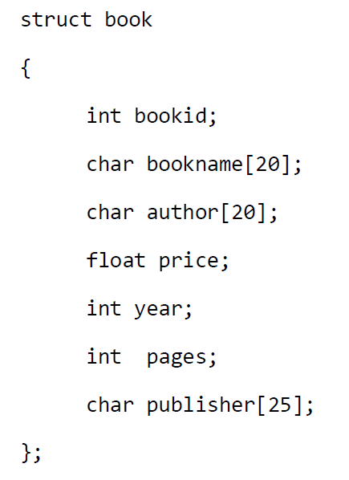
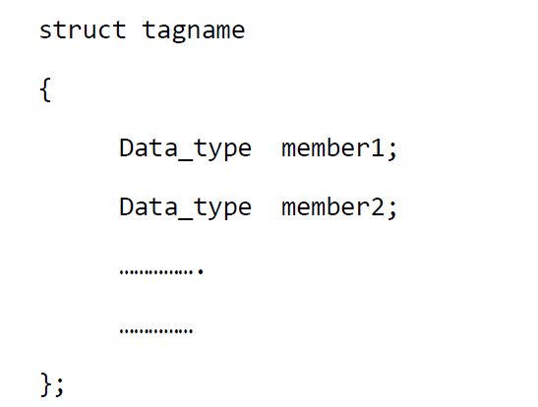
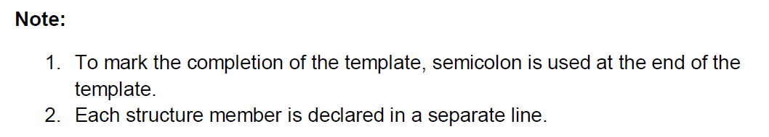
Structure Definition
Structures are defined first and then it is used for declaring structure variables.

Slide 58
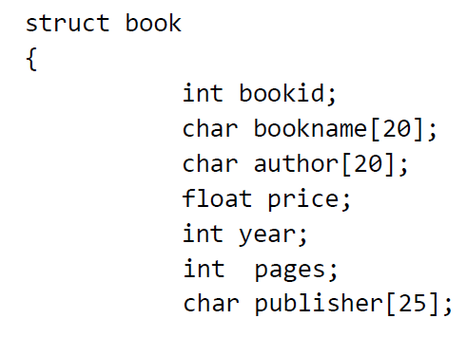
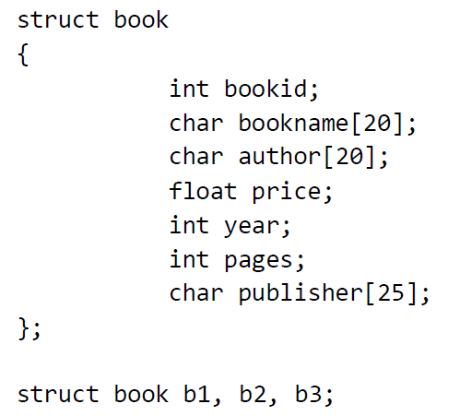

Declaration of structure variable at the time of defining the structure
Declaration of structure variable after defining the structure
The b1, b2, and b3 are structure variables of type struct book.

Slide 59
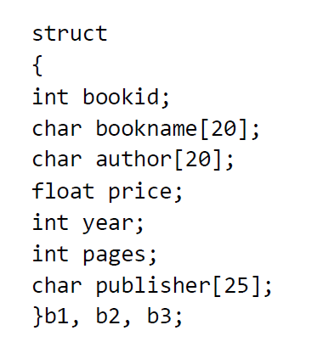
Structure tag name is optional.
Structure members are not variables.
They don‟t occupy memory until they are associated with a structure variable.
Declaration of structure variable at a later time is not possible with this type of declaration. It is a drawback in this method.
So the second method can be preferred.

Slide 60
Accessing Structure Members
There are many ways for storing values into structure variables.
The members of a structure can be accessed using a “dot operator” or “period operator”.
(eg) b1.author
b1 is a structure variable and author is a structure member

Slide 61
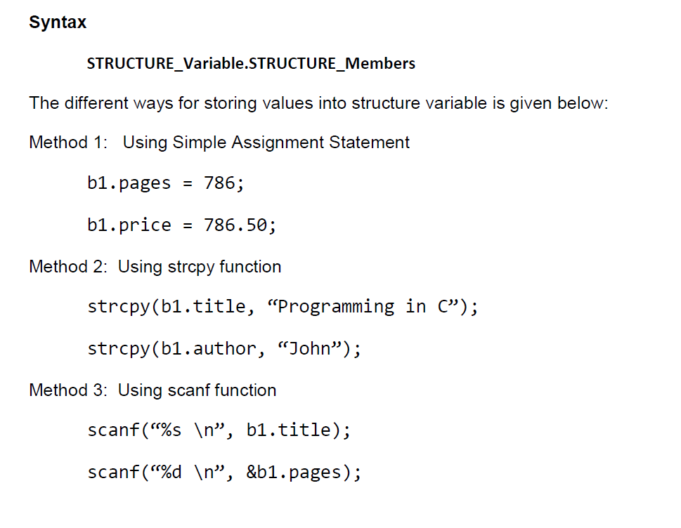

Slide 62
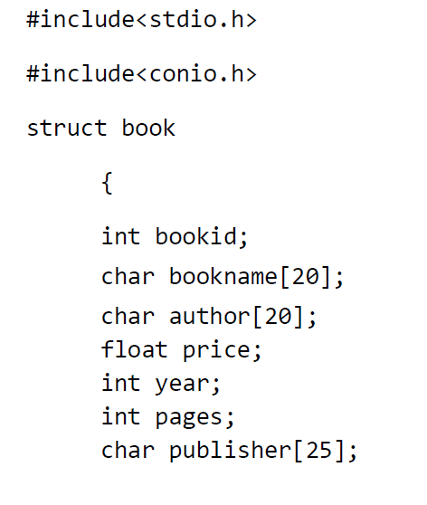
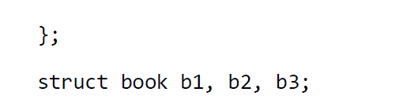

Slide 63
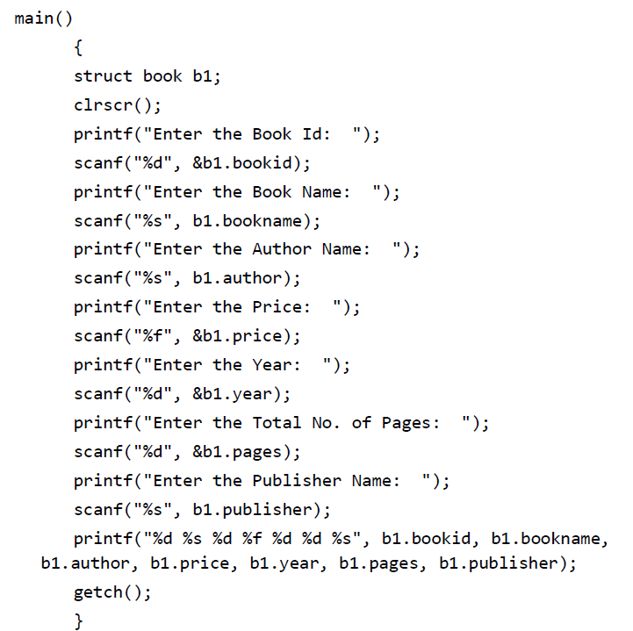

Slide 64
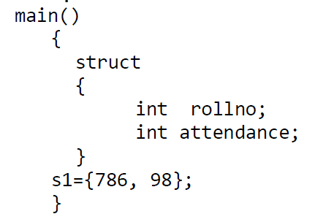
Structure Initialization
Like variables, structures can also be initialized at the compile time.
The above example assigns 786 to the rollno and 98 to the attendance.
Structure variable can be initialized outside the function also.

Slide 65
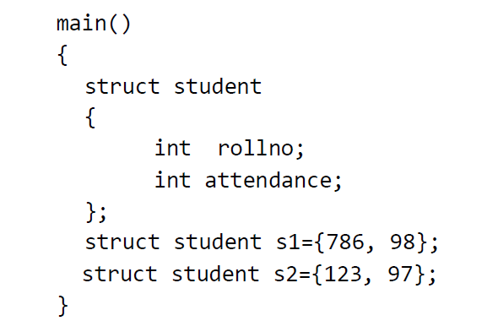
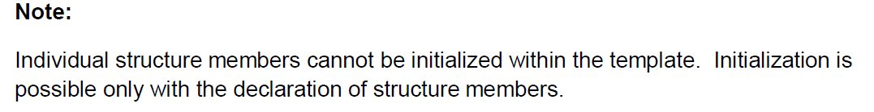

Slide 66
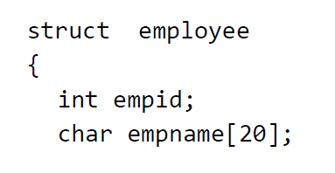
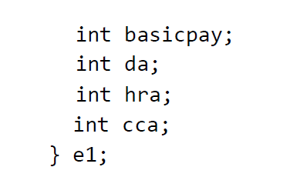
Nested Structures or Structures within Structures
Structures can also be nested. i.e A structure can be defined inside another structure.

Slide 67
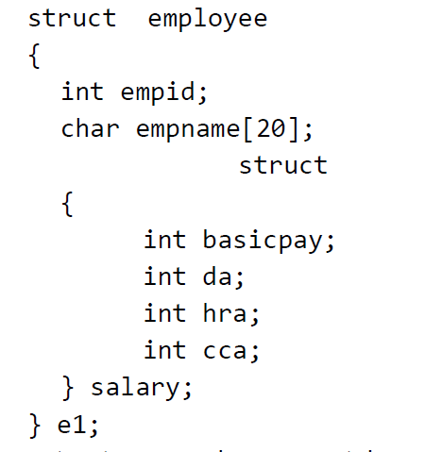
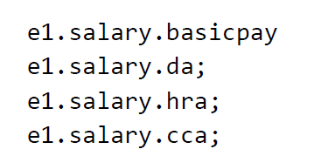
In the above structure, salary details can be grouped together and defined as a separate structure.
The structure employee contains a member named salary which itself is another structure that contains four structure members. The members inside salary structure can be referred as below:

Slide 68
Array of Structures
A Structure variable can hold information of one particular record. For example, single record of student or employee.
Suppose, if multiple records are to be maintained, it is impractical to create multiple structure variables.
In this case, we need “Array of Structures.
An array of structure is a group of structure elements under the same structure variables.
struct student s1[1000];
The values can be stored into the array of structures as follows:
s1[0].student_age = 19;

Slide 69
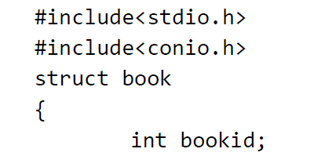
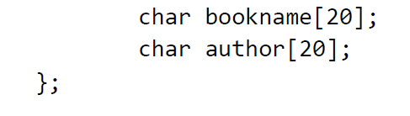
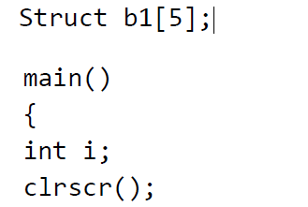
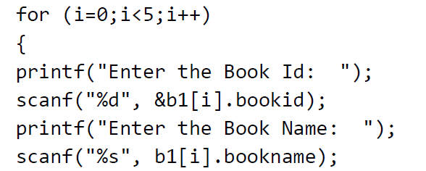

Slide 70
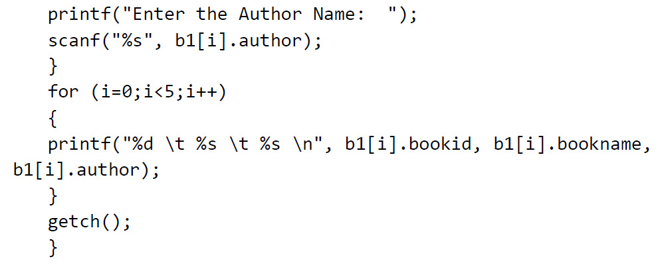
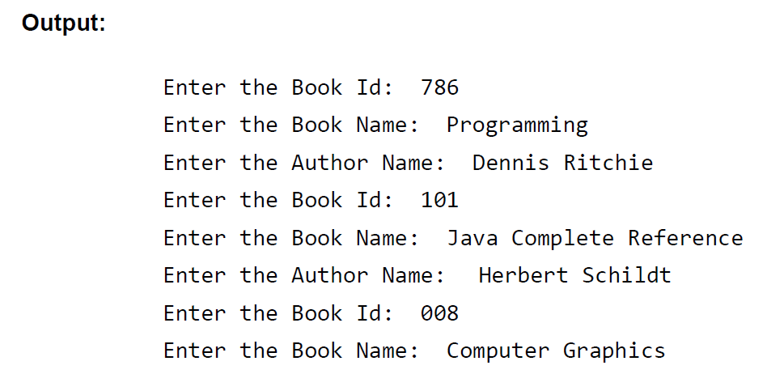

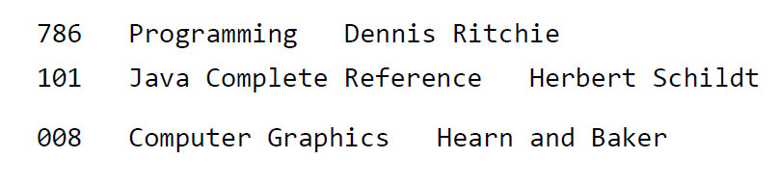

Slide 71
Function that returns Structure
The members of a structure can be passed to a function.
If a structure is to be passed to a called function , we can use any one of the following method.
Method 1 :- Individual member of the structure is passed as an actual argument of the function call. The actual arguments are treated independently. This method is not suitable if a structure is very large structure.

Slide 72
Method 2:- Entire structure is passed to the called function. Since the structure declared as the argument of the function, it is local to the function only. The members are valid for the function only. Hence if any modification done on any member of the structure , it is not reflected in the original structure.
Method 3 :- Pointers can be used for passing the structure to a user defined function. When the pointers are used , the address of the structure is copied to the function. Hence if any modification done on any member of the structure , it is reflected in the original structure.

Slide 73
Method 1
#include<stdio.h>
#include<conio.h>
void fun(int,float);
struct student
{
int roll;
float avg;
};
void main()
{
struct student a;
a.roll=56234;
a.avg=94.5;
clrscr();
fun(a.roll,a.avg);
getch();
}
void fun(int a,float b)
{
printf(“%d\n%.2f”,a,b);
}

Slide 74
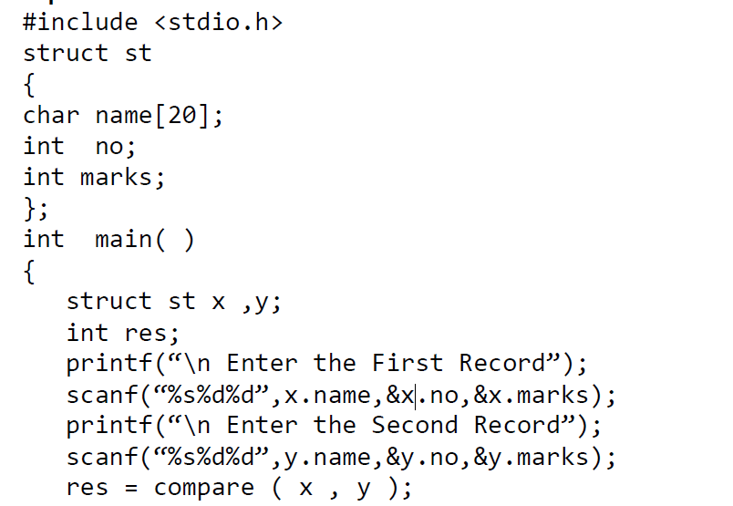
Method 2

Slide 75
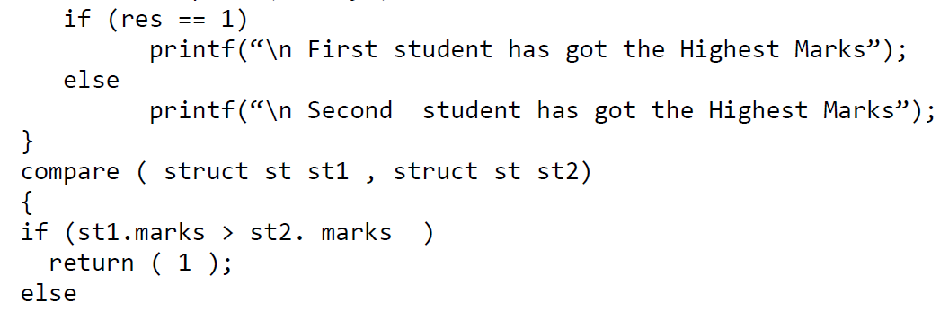
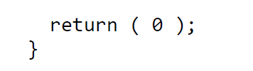
In the above example , x and y are the structures sent from the main ( ) function as the actual parameter to the formal parameters st1 and st2 of the function compare ( ).

Slide 76
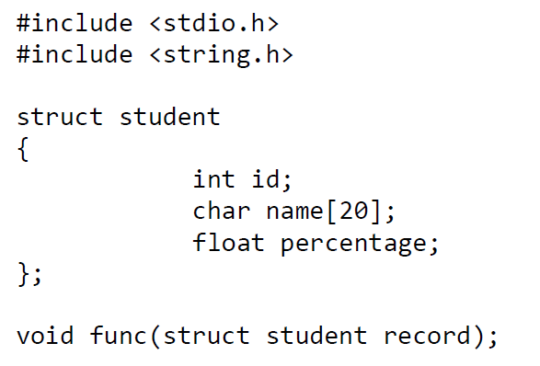
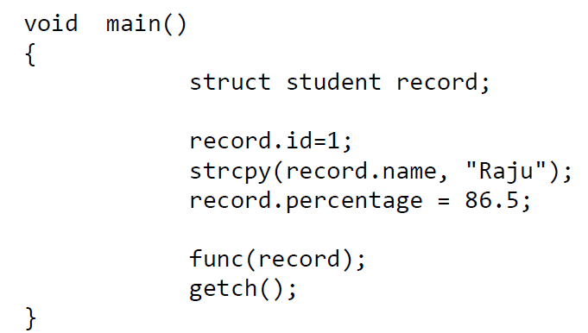
Method 2

Slide 77
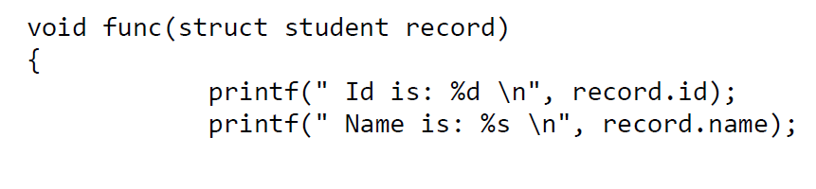

Slide 78
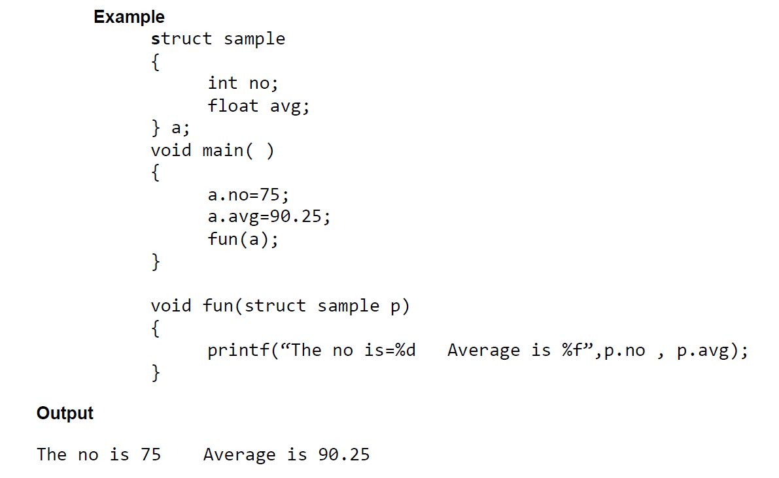
Structure as Function Argument

Slide 79
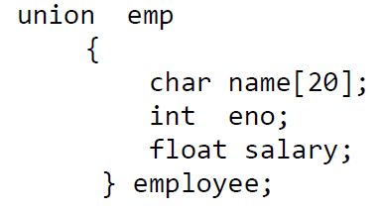
Union
The concept of Union is borrowed from structures and the formats are also same.
The distinction between them is in terms of storage. In structures , each member is stored in its own location but in Union , all the members are sharing the same location.
Though Union consists of more than one members , only one member can be used at a particular time.
The syntax is the same as structures but we use the keyword union instead of struct.

Slide 80

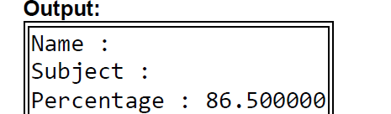
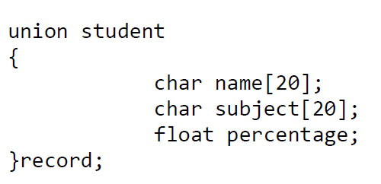
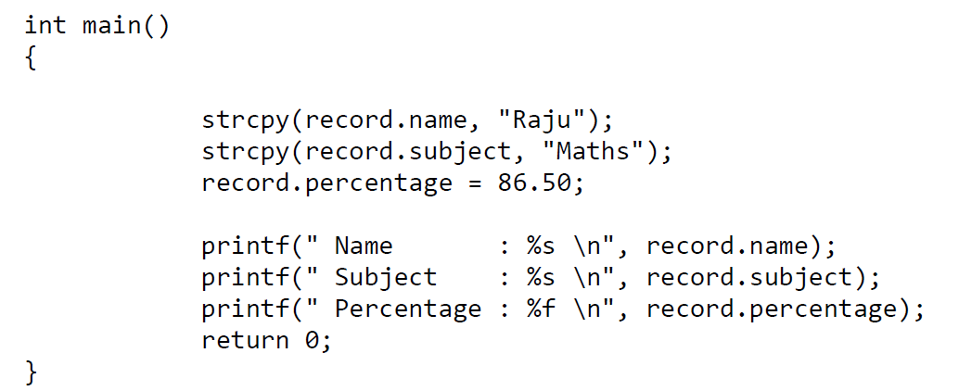

Slide 81
Thank You

